Slide 1
DCO status
draft-ietf-roll-efficient-npdao-18
- Rahul (IETF 107)

Slide 2
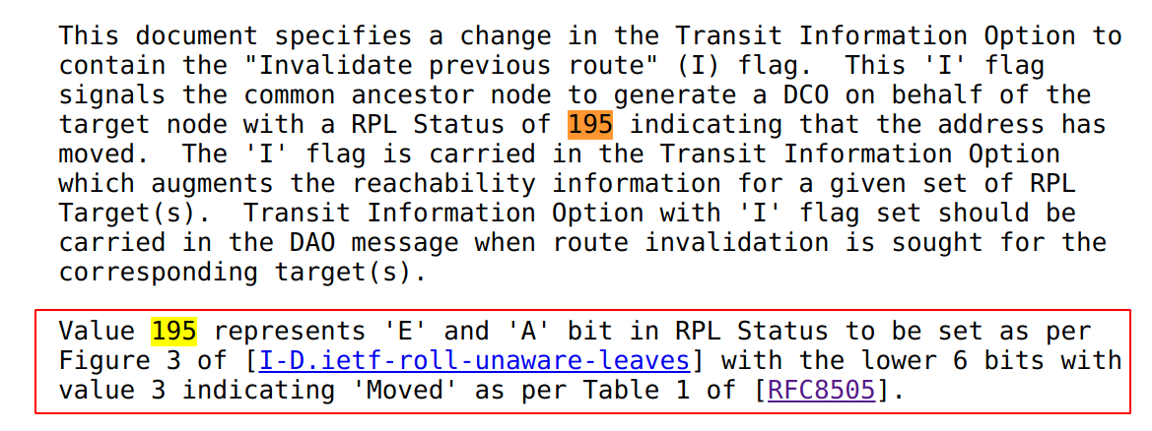
Updates

Slide 3
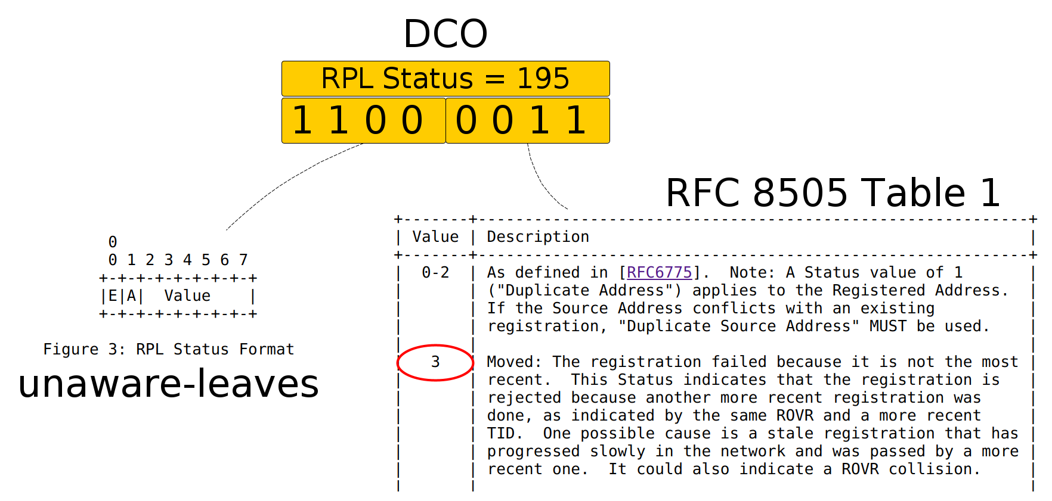
Why 195?
Use same Status of Moved from both RPL and 6Lo handling

